Slide 1
Analytical Dynamics Project 2 Double Link Pendulum Dynamics Simulation
By
Deepak Raina (2019MEZ8497)
Sandeep Kumar (2019MEZ8423)

Slide 2
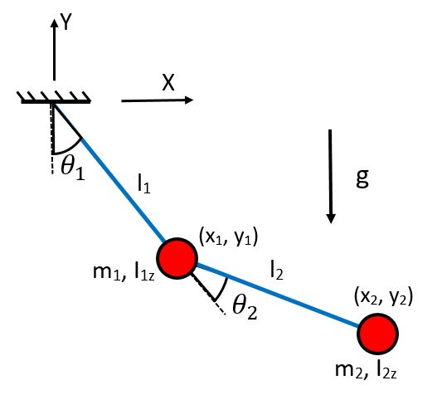
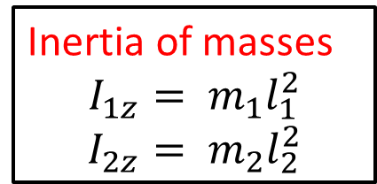
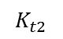
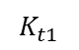
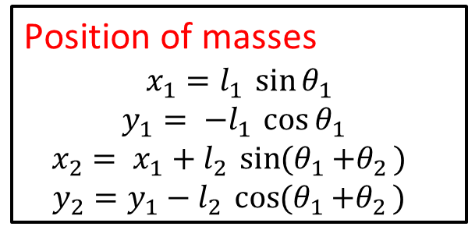
Case I: With 2 point masses
Assumptions:
Massless rods
Planar motion
$$K_{t1}$$
Inertia of masses
$$I_{1z}= m_{1}l_{1}^{2}$$
$$I_{2z}= m_{2}l_{2}^{2}$$
$$K_{t2}$$
Position of masses
$$x_{1}=l_{1 }\sin{θ_{1}}$$
$$y_{1}= {−l}_{1 }\cos{θ_{1 }}$$
$$x_{2}= {x_{1}+l}_{2 }\sin{{(θ}_{1 }+θ_{2 }) }$$
$$y_{2}={y_{1}−l}_{2 }\cos{{(θ}_{1 }+θ_{2 }) }$$

Slide 3
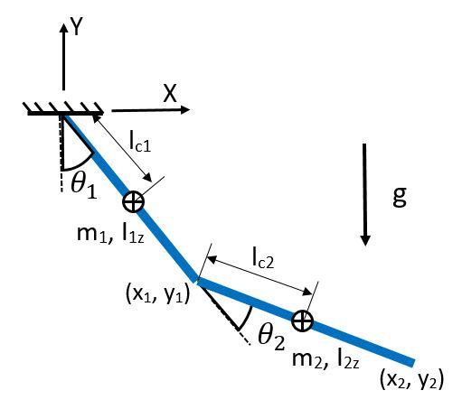
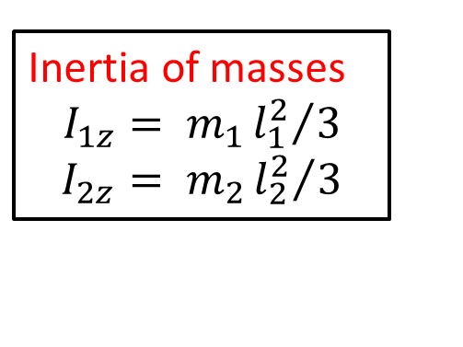
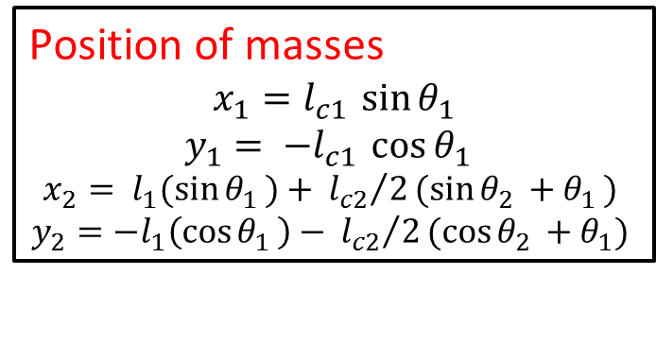
Case II: With 2 rods
Assumptions:
COM lies at center of link
Inertia of masses
$$I_{1z}= m_{1}{l_{1}^{2}}/3$$
$$I_{2z}= m_{2}{l_{2}^{2}}/3$$
Position of masses
$$x_{1}=l_{c1 }\sin{θ_{1}}$$
$$y_{1}= {−l}_{c1 }\cos{θ_{1 }}$$
$$x_{2}= {l_{1}(\sin{θ_{1 }})+}_{ }{l_{c2}}/2(sin{θ_{2 }+θ_{1 }) }$$
$$y_{2}=−{l_{1}\left(\cos{θ_{1 }}\right)−}_{ }{l_{c2}}/2(cos{θ_{2 }+θ_{1}) }$$

Slide 4
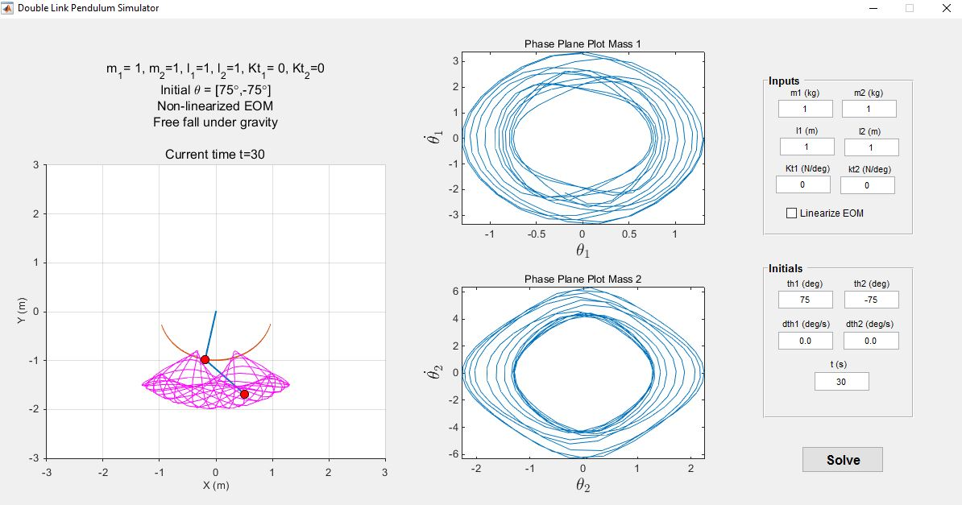
MATLAB GUI

Slide 5
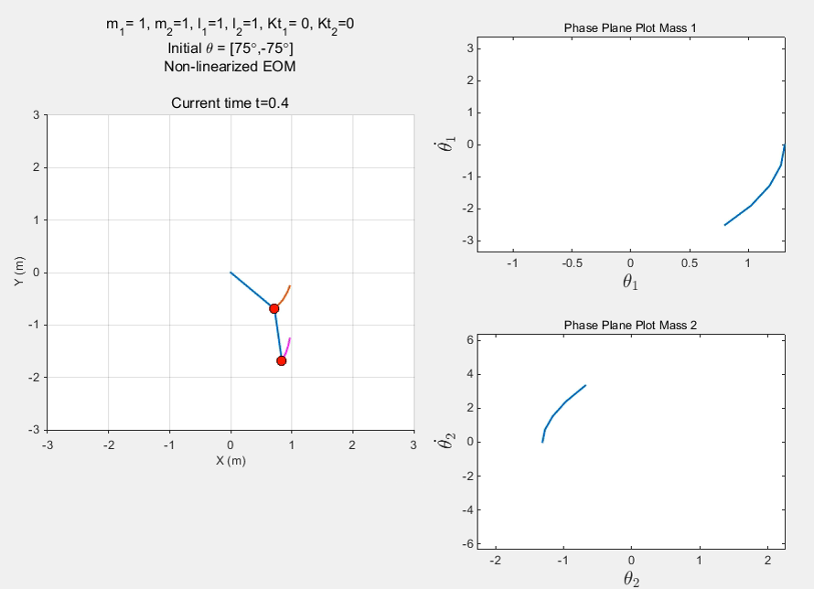

Slide 6
Analysis of simulations
For small angles, chaotic motion is absent, for large angle chaos motion is present.
For non-linearized case, there is more random motion otherwise its smooth.
Presence of torsional spring restrict the large value of angles, hence prevents chaotic motion.
Chaotic behavior
Small changes in initial conditions can lead to large changes in the long-term behavior of the system
Motion of the system is difficult to predict
Double pendulum is a chaotic system

Slide 7
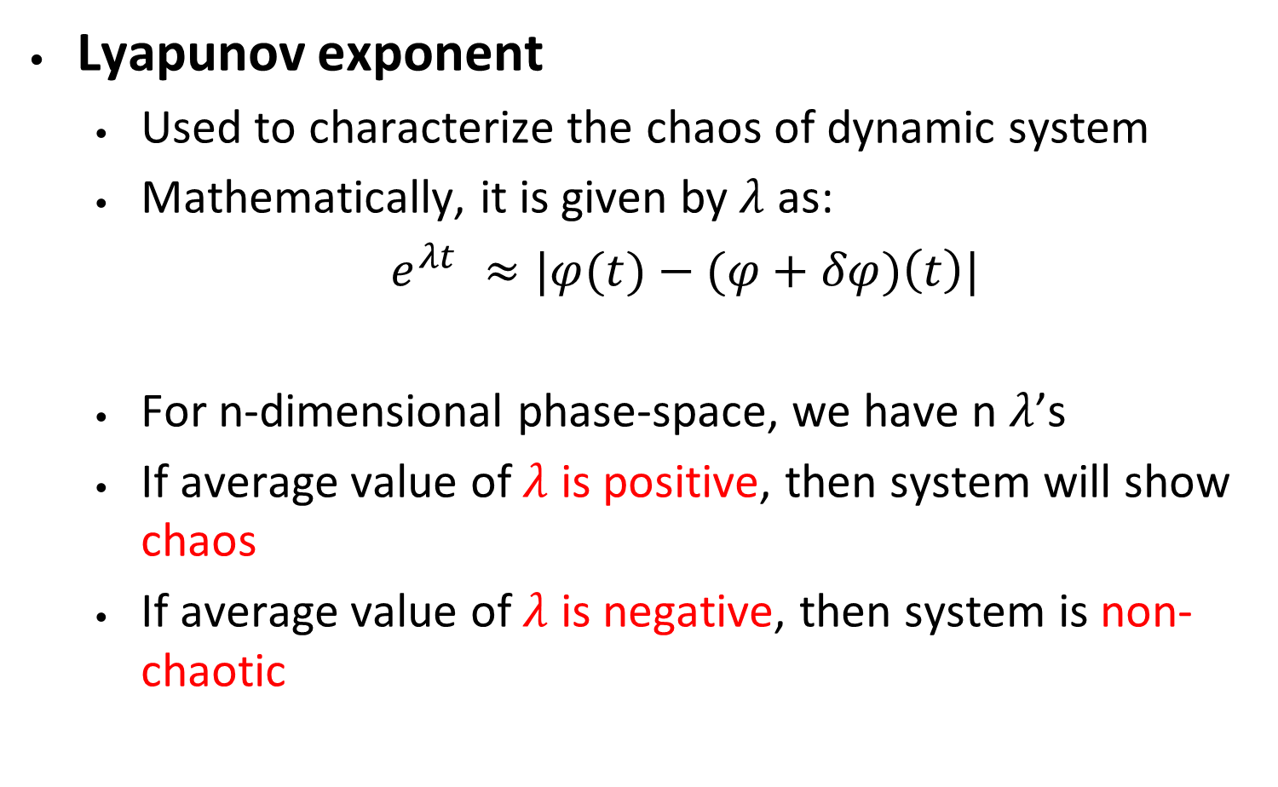
Prediction of Chaotic Behavior
Lyapunov exponent
Used to characterize the chaos of dynamic system
Mathematically, it is given by$λ$ as:
$e^{λt} ≈|φ(t)−(φ+δφ)\left(t\right)|$
For n-dimensional phase-space, we have n $λ$’s
If average value of $λ$ is positive, then system will show chaos
If average value of $λ$ is negative, then system is non-chaotic
Reference: Levien, R. B., and S. M. Tan. "Double pendulum: An experiment in chaos." American Journal of Physics 61.11 (1993): 1038-1044.

Slide 8
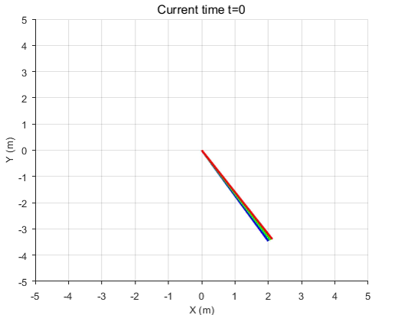
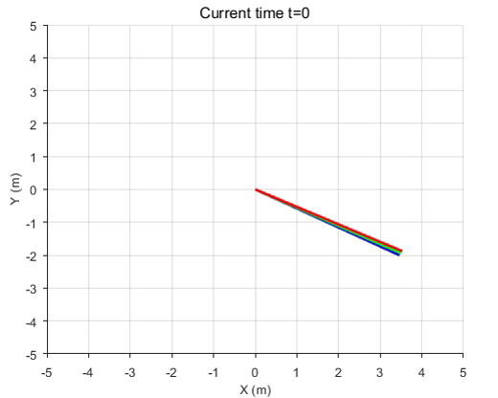
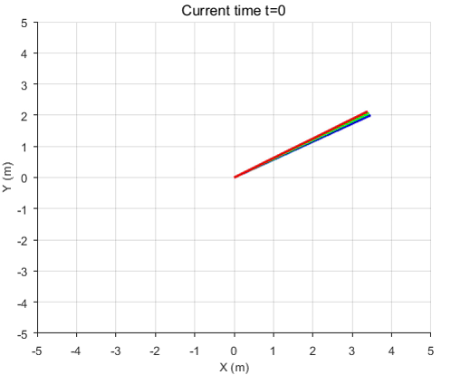
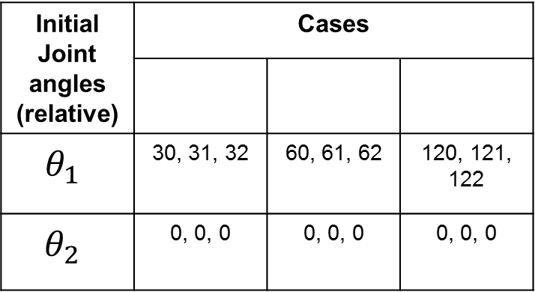
Effect of initial condition
1
2
3
Initial Joint angles (relative) | Cases
$$θ_{1}$$ | 30, 31, 32 | 60, 61, 62 | 120, 121, 122
$$θ_{2}$$ | 0, 0, 0 | 0, 0, 0 | 0, 0, 0
1
2
3

Slide 9
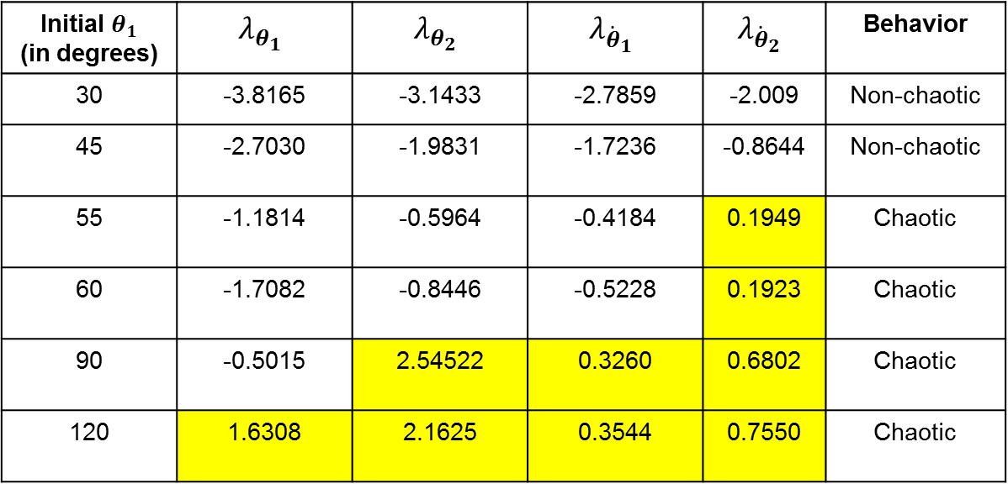
Analysis of chaotic behavior
Effect of initial condition:
Varying initial angle of first link
$m_{1}=1, m_{2}=1$, $l_{1}=1$, $l_{2}=1,θ_{2}= {\dot{θ}}_{1}={\dot{θ}}_{2}=0, t=100s$
Initial $θ_{1}$ (in degrees) | $$λ_{θ_{1}}$$ | $$λ_{θ_{2}}$$ | $$λ_{{\dot{θ}}_{1}}$$ | $$λ_{{\dot{θ}}_{2}}$$ | Behavior
30 | -3.8165 | -3.1433 | -2.7859 | -2.009 | Non-chaotic
45 | -2.7030 | -1.9831 | -1.7236 | -0.8644 | Non-chaotic
55 | -1.1814 | -0.5964 | -0.4184 | 0.1949 | Chaotic
60 | -1.7082 | -0.8446 | -0.5228 | 0.1923 | Chaotic
90 | -0.5015 | 2.54522 | 0.3260 | 0.6802 | Chaotic
120 | 1.6308 | 2.1625 | 0.3544 | 0.7550 | Chaotic

Slide 10
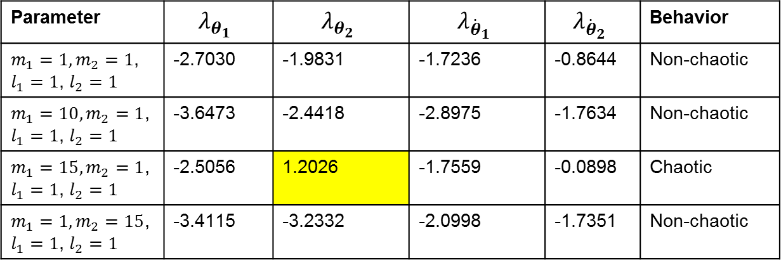
Analysis of chaotic behavior
Effect of initial condition:
Varying mass of links
$$θ_{1}=45 °,θ_{1}=0, {\dot{θ}}_{1}={\dot{θ}}_{2}=0, t=100s$$
Parameter | $$λ_{θ_{1}}$$ | $$λ_{θ_{2}}$$ | $$λ_{{\dot{θ}}_{1}}$$ | $$λ_{{\dot{θ}}_{2}}$$ | Behavior
$m_{1}=1, m_{2}=1$, $l_{1}=1$, $l_{2}=1$ | -2.7030 | -1.9831 | -1.7236 | -0.8644 | Non-chaotic
$m_{1}=10, m_{2}=1$, $l_{1}=1$, $l_{2}=1$ | -3.6473 | -2.4418 | -2.8975 | -1.7634 | Non-chaotic
$m_{1}=15, m_{2}=1$, $l_{1}=1$, $l_{2}=1$ | -2.5056 | 1.2026 | -1.7559 | -0.0898 | Chaotic
$m_{1}=1, m_{2}=15$, $l_{1}=1$, $l_{2}=1$ | -3.4115 | -3.2332 | -2.0998 | -1.7351 | Non-chaotic

Slide 11
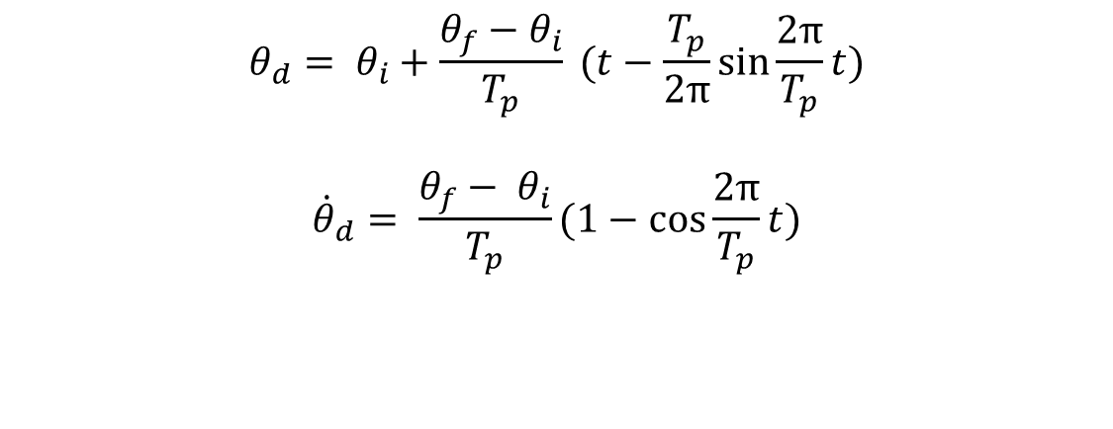
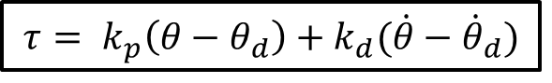
Extra Results
Forced Control
Applied Torque
Desired Trajectory: Cycloidal
$$τ= k_{p}\left(θ−θ_{d}\right)+k_{d}(\dot{θ}−{\dot{θ}}_{d})$$
$$θ_{d}= θ_{i}+\frac{θ_{f}−θ_{i}}{T_{p}} (t−\frac{T_{p}}{2π}\sin{\frac{2π}{T_{p}}t)}$$
$${\dot{θ}}_{d}= \frac{θ_{f}− θ_{i}}{T_{p}}(1−\cos{\frac{2π}{T_{p}}t)}$$

Slide 12
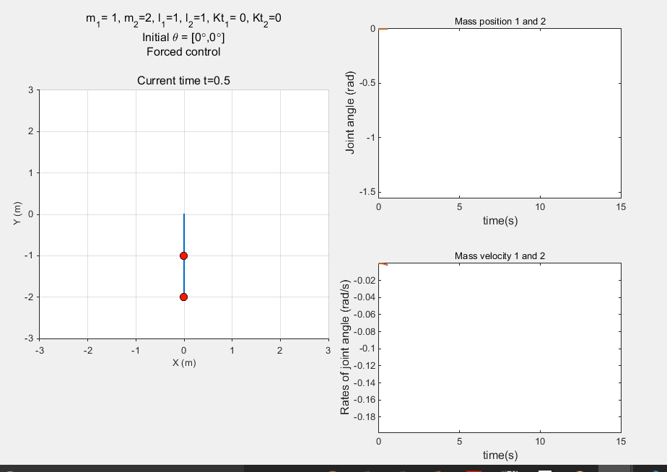
Simulation Results
Forced control:

Slide 13
Thank You

